Slide 1
Artificial intelligence and participatory data governance for intangible heritage
Harriet Deacon
DAIM and Wilberforce Institute, University of Hull
Notes:
multimedia

Slide 2
Concepts
Images: https://ich.unesco.org/en/dive?display=domain#tabs and https://www.mycase.com/blog/ai/ai-vs-generative-ai/
Intangible cultural heritage
Artificial Intelligence

Slide 3
Intangible cultural heritage: a legal concept imagined in the 1950s
1950s and 60s
2003
Japanese Law for the Protection of Cultural Property in 1950 and Korean Act for Cultural Property Preservation in 1962 covered what was later known as ICH
Intangible Heritage Convention approved by UNESCO General Assembly 2003, comes into force in 2006. Emphasis on community participation and consent, but assigns no new community rights over heritage.
1970s to 2000s
2015 to present
Increased interest in non-tangible cultural forms as heritage, linked to discussions about community rights over their heritage.
Increased interest in economic dimensions of ICH safeguarding, linked to Sustainable Development Goals

Slide 4
AI: a technology imagined in the 1950s
1950s
2000-2019
Alan Turing introduces the Turing test in 1950.
In 1956, Dartmouth workshop / John McCarthy coins the term ‘artificial intelligence’
New methods for machine learning developed using natural language processing and neural networks
1960s and 1970s
2018 to present
Early work on chatbots and robots, followed by an AI winter in the 1980s and 1990s
Cumulatively more powerful multi-modal generative AI models drive widespread use of AI and debate about its impact and regulation

Slide 5
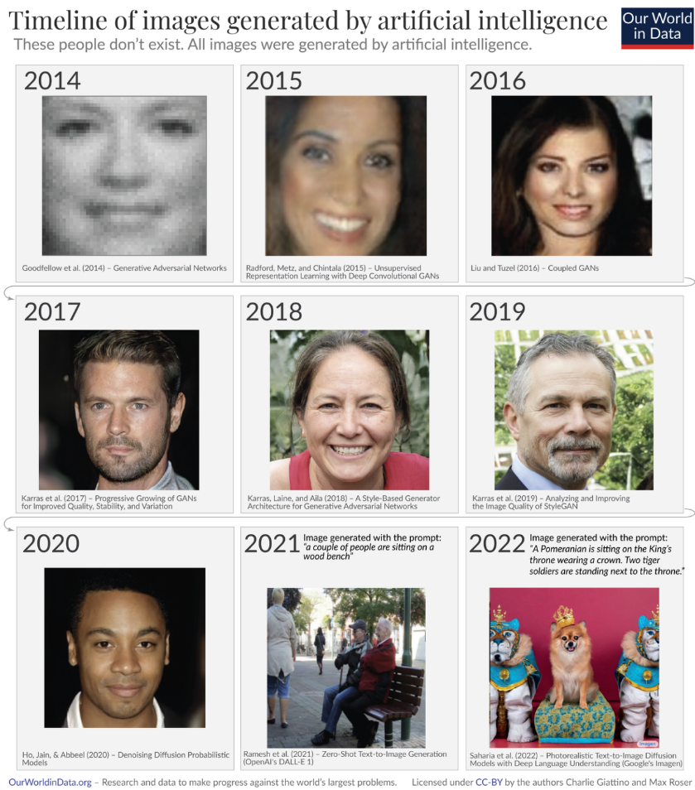
AI is already widely used for …
Navigating using online maps
Recommending social media posts, music and videos
Internet search
Predictive text, translation, speech recognition
Self-driving cars
Chatbots
Generating new text and pictures (generative AI)
https://ourworldindata.org/brief-history-of-ai

Slide 6
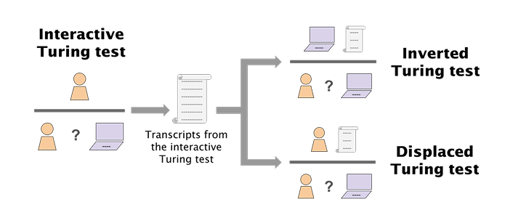
Machine intelligence versus human intelligence
Artificial intelligence
Human intelligence
No direct knowledge of the real world
Social environments are not important
Does not tire, can access all data at any time
Can store enormous quantities of information
Can amplify bias present in human-generated datasets
Embodied knowledge of the real world
Social connection and cultural meaning drive action
Limited capacity for memory and concentration
Limited storage / retrieval capacity
Cognitive biases and stereotyping used to manage / interpret data – can be misleading / prejudiced
GPT-4 is judged more human than humans in displaced and inverted Turing tests, where they only have access to transcripts and cannot adapt questions on the fly (Rathi et al. 2024)

Slide 7
Data is the juice: sweet and sour
AI systems have been trained on data from cultural institutions and researchers – much of it from just a few countries
Not all relevant data are available in digital form
Some kinds of data are not easy to represent digitally
Racism, sexism and other forms of human bias and discrimination are reflected in the data
AI systems can magnify existing bias in the data

Slide 8
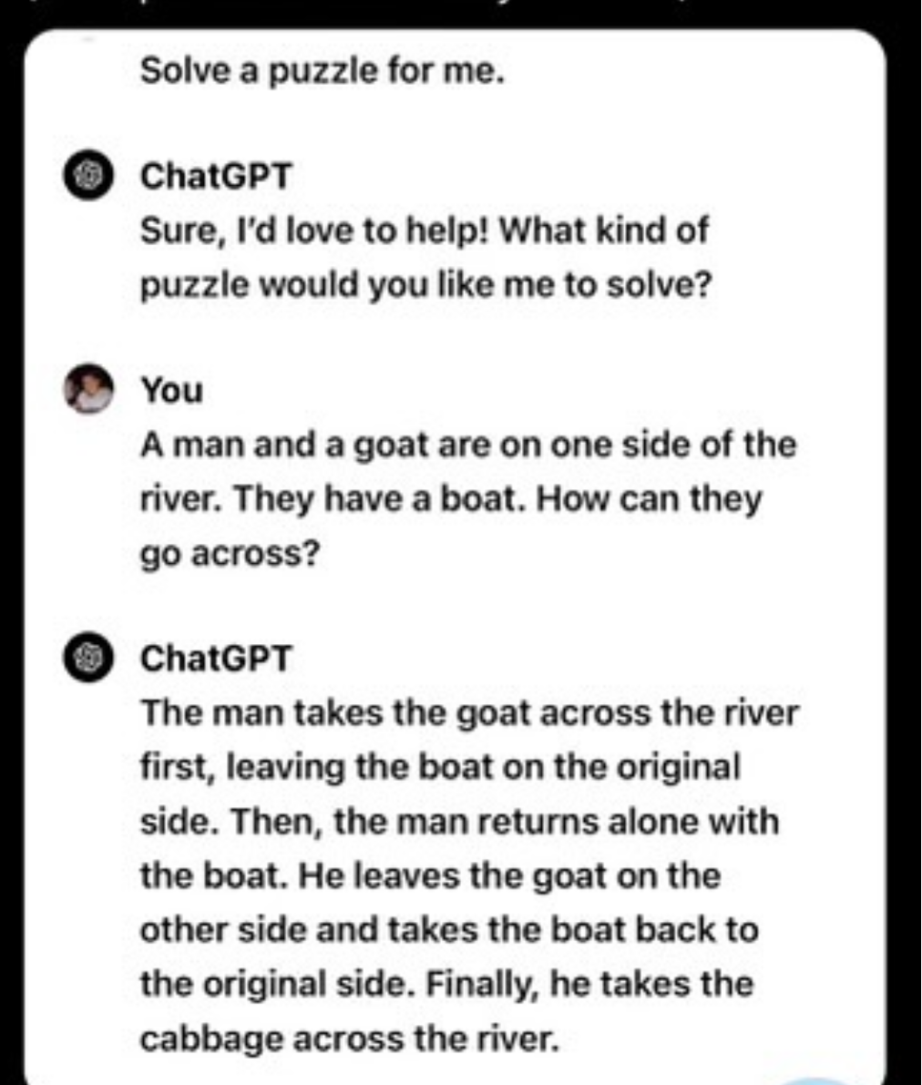
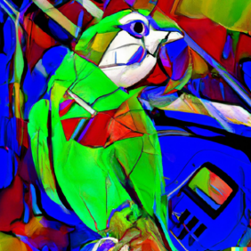
The stochastic parrot
Generative AI based on large language models is sophisticated predictive text.
Digital data as such does not represent the world perfectly or enable AI models to know how the world works, even if there is a lot of data.
Nevertheless, AI can affect how we operate in the real world, our relationships to each other and our cultural practice.

Slide 9
Participatory data governance
Data about culture has become more valuable because AI tools can use it in new ways
Digital data about ICH does not fully represent or replace ICH practice, meaning and value – but interacts with it
This means we need to talk more about the relationship between the digital and the real worlds
Community rights to access and use digital data about their heritage may be needed for custodianship / safeguarding
This makes participatory data governance – where communities engage as data owners - more important in the age of AI
Ayana et al. 2024 https://royalsocietypublishing.org/doi/10.1098/rsos.231994

Slide 10
Lawful, ethical and robust AI
Human agency and oversight
Technical robustness and safety
Privacy and data governance
Transparency
Diversity, non-discrimination and fairness
Societal and environmental well-being
Accountability
European Commission High-Level Expert Group on AI -Ethics Guidelines for Trustworthy Artificial Intelligence (2019)
Notes:
Issues: human rights and well-being; emotional harm; accountability and responsibility; security,
privacy, accessibility and transparency; safety and trust; social harm and social justice; lawfulness
and justice; control and the ethical use (or misuse) of AI; environmental harm and sustainability;
informed use; existential risk.
In 2021, UK Government published the “Algorithmic Transparency Standard” tracking how the public sector uses AI

Slide 11
UNESCO Recommendation on AI ethics (2021)
94. Member States are encouraged to incorporate AI systems, where appropriate, in the preservation, enrichment, understanding, promotion, management and accessibility of tangible, documentary and intangible cultural heritage
95. Member States are encouraged to examine and address the cultural impact of AI systems
96. Member States should promote AI education and digital training for artists and creative professionals t
98. Member States should … promote a diverse supply of and plural access to cultural expressions, and in particular to ensure that algorithmic recommendation enhances the visibility and discoverability of local content.
99. Member States should foster new research at the intersection between AI and intellectual property (IP)
100. Member States should encourage museums, galleries, libraries and archives at the national level to use AI systems to highlight their collections and enhance their libraries, databases and knowledge base, while also providing access to their users.
Notes:
94. Member States are encouraged to incorporate AI systems, where appropriate, in the preservation, enrichment, understanding, promotion, management and accessibility of tangible, documentary and intangible cultural heritage, including endangered languages as well as indigenous languages and knowledges, for example by introducing or updating educational programmes related to the application of AI systems in these areas, where appropriate, and by ensuring a participatory approach, targeted at institutions and the public.
95. Member States are encouraged to examine and address the cultural impact of AI systems, especially natural language processing (NLP) applications such as automated translation and voice assistants, on the nuances of human language and expression. Such assessments should provide input for the design and implementation of strategies that maximize the benefits from these systems by bridging cultural gaps and increasing human understanding, as well as addressing the negative implications such as the reduction of use, which could lead to the disappearance of endangered languages, local dialects, and tonal and cultural variations associated with human language and expression.
96. Member States should promote AI education and digital training for artists and creative professionals to assess the suitability of AI technologies for use in their profession, and contribute to the design and implementation of suitable AI technologies, as AI technologies are being used to create, produce, distribute, broadcast and consume a variety of cultural goods and services, bearing in mind the importance of preserving cultural heritage, diversity and artistic freedom.
97. Member States should promote awareness and evaluation of AI tools among local cultural industries and small and medium enterprises working in the field of culture, to avoid the risk of concentration in the cultural market.
98. Member States should engage technology companies and other stakeholders to promote a diverse supply of and plural access to cultural expressions, and in particular to ensure that algorithmic recommendation enhances the visibility and discoverability of local content.
99. Member States should foster new research at the intersection between AI and intellectual property (IP), for example to determine whether or how to protect with IP rights the works created by means of Al technologies. Member States should also assess how AI technologies are affecting the rights or interests of IP owners, whose works are used to research, develop, train or implement AI applications.
100. Member States should encourage museums, galleries, libraries and archives at the national level to use AI systems to highlight their collections and enhance their libraries, databases and knowledge base, while also providing access to their users.

Slide 12
Opportunities and challenges
Creative Industries
Tangible heritage
Intangible heritage
New works
Style mimicry
Voice cloning
Digital twins
Collections management
Data analysis
New adaptations
New audiences
Data analysis / management
New transmission methods
Style mimicry
Misrepresentation
Misappropriation / lack of attribution

Slide 13
Repatriation
Example
Researcher owns the copyright in research publications
Drum acquired by museum
Researcher / museum owns the copyright in photographs and video
Traditional songs and dances not covered by IP rights, but performers may have some rights
Museum owns the copyright in cataloguing data
Drum repatriated by museum
Indigenous cultural practice with songs, rituals, drumming, dancing, communally authored over generations
Museum owns database rights in database of images / thin copyright in digital surrogates

Slide 14
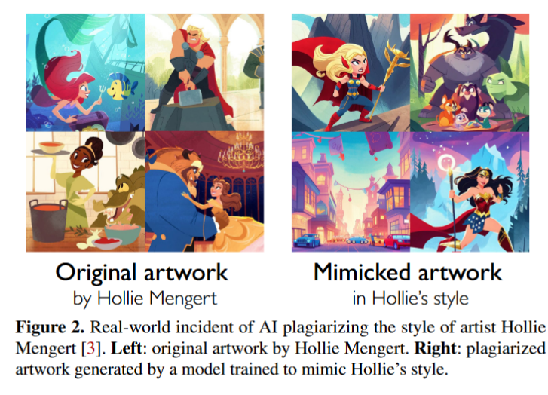
Style mimicry in contemporary arts
Many LLMs are trained on data scraped from the internet, usually without the consent of rights holders or those who generated the data.
Style mimicry has become much easier and cheaper.
This has been challenged in various courts, but not yet decided.
Some regions, e.g. EU, are developing regulations allowing text and data mining, and/or requiring opt-outs.
Shan et al. 2023 arXiv:2302.04222

Slide 15
The Italian plumber problem: concept sparsity
Stable Diffusion: “video game italian plumber”
GPT-4: “draw an italian plumber from a video game”
https://www.understandingai.org/p/the-ai-community-needs-to-take-copyright
Notes:
Still doing it https://chat.openai.com/g/g-2fkFE8rbu-dall-e/c/8bfaf8d7-8ed8-420b-b096-128298a532fe

Slide 16
The case of Greg Rutkowski
A digital artwork by Greg Rutkowski https://www.bbc.co.uk/news/uk-wales-66099850
https://decrypt.co/150575/greg-rutkowski-removed-from-stable-diffusion-but-brought-back-by-ai-artists
Notes:
References
https://decrypt.co/150575/greg-rutkowski-removed-from-stable-diffusion-but-brought-back-by-ai-artists
the LoRa, a small, very specific model trained to emulate specific things like art styles, faces, stances or color gradings. A Lora trained to recreate Rutkowski's style, now freely available on Civitai.
https://www.cbc.ca/radio/asithappens/artificial-intelligence-ai-art-ethics-greg-rutkowski-1.6679466
Digital artist Greg Rutkowski’s name has been used as a prompt in AI tools that generate art more than 400,000 times since September 2022 - more times than the artists Pablo Picasso and Leonardo da Vinci- but without his consent. Greg said: "The first month that I discovered it, I realised that it will clearly affect my career and I won't be able to recognise and find my own works on the internet. The results will be associated with my name, but it won't be my image. It won't be created by me. So it will add confusion for people who are discovering my works. All that we've been working on for so many years has been taken from us so easily with AI."
Artist Harry Hambley said he thought there was more to art than how it looked.
"At the end of the day I think that there's a bigger reason why people are invested in Ketnipz and I don't think it's just the mere aesthetics of it.
"I think there's a personality behind it that I don't think someone imitating can really tap into."
https://www.bbc.co.uk/news/uk-wales-66099850

Slide 17
Automated style mimicry
https://civitai.com/models/117635/greg-rutkowski-inspired-style-lora-sdxl
https://www.patreon.com/Lykon275

Slide 18
Artists responding to data scraping
Spawning, an organization founded by artists Mat Dryhurst and Holly Herndon, created tools to manage opt-outs, check whether artists’ works were used in training and protect against scraping
HuggingFace (the largest repository of models and datasets) and Stability AI (creators of Stable Diffusion) have both agreed to respect the Do Not Train registry established by Spawning.
Artists supported development of Glaze and Nightshade: style cloaks and poisoning of foundational models - ‘technological protection measures’ / ‘digital rights management’
Have I Been Trained?
https://spawning.ai/
https://glaze.cs.uchicago.edu/index.html
Shan et al. 2023 and 2024
Notes:
See https://www.technologyreview.com/2022/12/16/1065247/artists-can-now-opt-out-of-the-next-version-of-stable-diffusion/
Stable Diffusion is based on the open-source LAION-5B data set, which is built by scraping images from the internet, including copyrighted works of artists.
Karla Ortiz, an artist and a board member of the Concept Art Association, an advocacy organization for artists working in entertainment, says The fact that artists have to opt out means “that every single artist in the world is automatically opted in and our choice is taken away … The only thing that Stability.AI can do is algorithmic disgorgement, where they completely destroy their database and they completely destroy all models that have all of our data in it,” she says.
Glaze
Developed by scientists at University of Chicago
Glaze released in March 2023, named by Time Magazine as one of the best inventions of 2023
Purpose is to prevent style mimicry
Changes pixels in subtle ways that are invisible to the human eye, but cause Generative AI tools to interpret the image as something different than it actually is
Changes pixels in subtle ways that are invisible to the human eye, but cause machine learning tools to interpret the image as something different from what it actually is.
Glaze is free to use, but not open source, so as to help prevent adaptive attacks.
WebGlaze – free web service that can be run from any device with a browser. (invite-only)
Named by Time magazine as one of the best inventions of 2023.
Glaze protects artists against models that use their work for fine-tuning, but does not prevent their work from being scraped and used to train models.
This is why they created Nightshade.
Preprint released in October 2023, code released this year
“Poisons” digital images with invisible changes that cause AI tools to misinterpret them
The more poisoned images used to train models, the lower the accuracy – potentially damaging future generations of Generative AI
Idea is to disincentive companies which scrape training data from the internet.
The system “is meant to affect model trainers who disregard copyright, opt-out lists and do-not-scrape directives,” he added. “Ethical companies should have nothing to worry about from Nightshade.” (Forbes)
Tool has not been released.
Wants to give power back to artists.
Might add Nightshade to Glaze as an optional enhancement. Artists can choose to use it or not.

Slide 19
Glaze
Confusing style allocations
Shan et al. 2023

Slide 20
Pathways to impact
practice
transmission
social meaning and value
documentation / data management
attribution to community
reputation
economic benefit
community control / custodianship

Slide 21
AI and data governance: ICH
Management and analysis of ICH data
Documentation and representation of ICH
Practice and transmission of ICH
Analyzing living heritage expressions, for example using neural networks to analyse folk song lyrics in China (Huang and Song 2022), and using the cosine similarity method to classify expert values associated with the technology of windcatchers in Iran (Foroughi et al. 2024). Trochidis et al. (2019) used computational audio analysis, machine learning and visualization techniques to analyse music from the Arab region and the Swahili coast.
Managing heritage data and linking data across collections (Weber et al. 2023), for example classifying living heritage related images (Mutathir et al 2023 on Indonesian wayang).
Documenting living heritage forms, for example using machine learning or extended reality (XR) techniques in analysis of dance (Rallis et al. 2020 on folk dances in Greece; Stacchio et al. 2024 on the classical dance technique of Nureyev). Hou et al. (2024) discuss the challenge of capturing and transmitting embodied knowledge and representing tacit knowledge around dance traditions and other forms of ICH, using multimodal technologies for motion capture and linking them to archival sources.
Creating AI-generated representations of living heritage (e.g. Cui and Fu (2023) creating an interactive museum display of a martial art form, and Zang and Jing 2022, see also Pistola et al. 2021 on interactive representations of traditional dance skills).
Managing ecological resources using a combination of traditional knowledge and AI tools, for example, the management of the Kakadu wetlands in Australia or Inuit fishing grounds in the Arctic.
Use of AI tools in traditional medicine, for example assisting in herbal medicine development (Amabie et al. 2024).
Generating new iterations of a traditional style (e.g. Zhao and Cui (2022) on generation of new cloisonne designs based on datasets of traditional cloisonne products in China; Zhang et al. (2023) on AI-generated traditional New Year prints; and Deng et al. (2023) on modifications to traditional clothing designs).
Transmission of language, for example by improving automated translation of Indigenous languages, or mainstreaming them in services such as Siri. The Maori in New Zealand/Aotearoa used AI tools (Walter and Kukutai 2018), but community experiences were mixed. An Indigenous education project in Australia uses AI and other digital tools for Indigenous cultural education, and teaches digital literacy through cultural education. Bouziane and Echchaoui (2024) discuss the difficulty of translating cultural concepts using machine translation of Doukkala Moroccan proverbs into English.

Slide 22
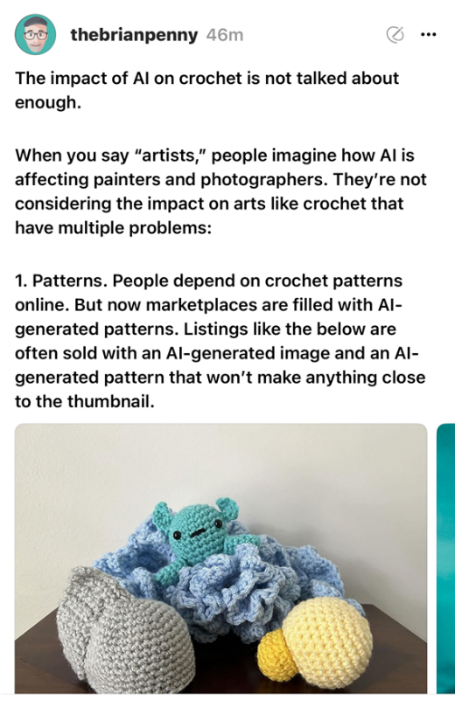
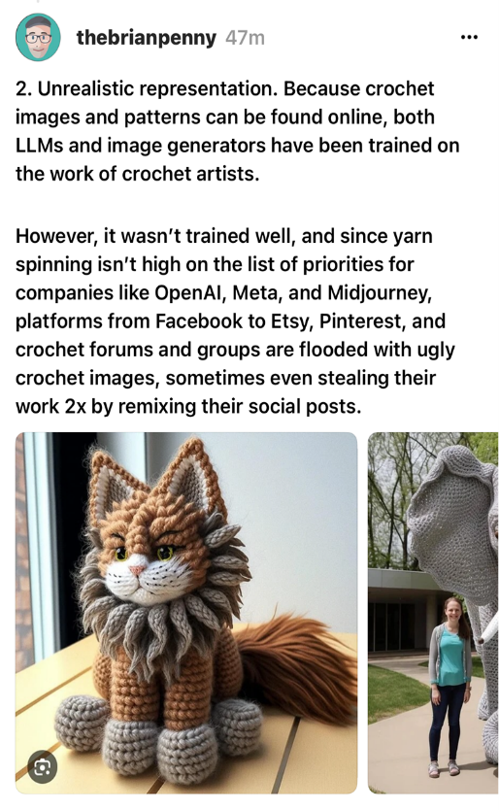
Indirect effects: the case of crochet
@theBrianPenny, Threads, 11 April 2024

Slide 23
Heritage-sensitive economic uses of ICH: consider multiple dimensions
COMMUNITY EMPOWERMENT and benefit
HERITAGE SKILLS REPERTOIRE
HERITAGE SENSITIVE INNOVATION
REPUTATION
hipams.org

Slide 24
Collaborative innovation
Deng et al. (2023:5810) used AI technology to generate new designs for women of the Biasha Miao ethnic minority, alongside more made-to-measure fit and choice of fabric.
Many Miao women were already wearing non-traditional clothes and moving to cities, so improving the fit and modernising the design of the clothes may in fact encourage younger women to value traditional clothing more, and make it more useable. Deng et al. (2023) noted that the development of modified traditional clothing designs was intended to complement rather than replace crafts associated with making of traditional attire.
Collaboration with Miao artisans and cultural experts was used to mitigate a number of risks:
Cultural appropriation
Misrepresentation of the heritage
Undermining the use of traditional craftsmanship to make Miao clothing

Slide 25
Deng et al. 2023

Slide 26
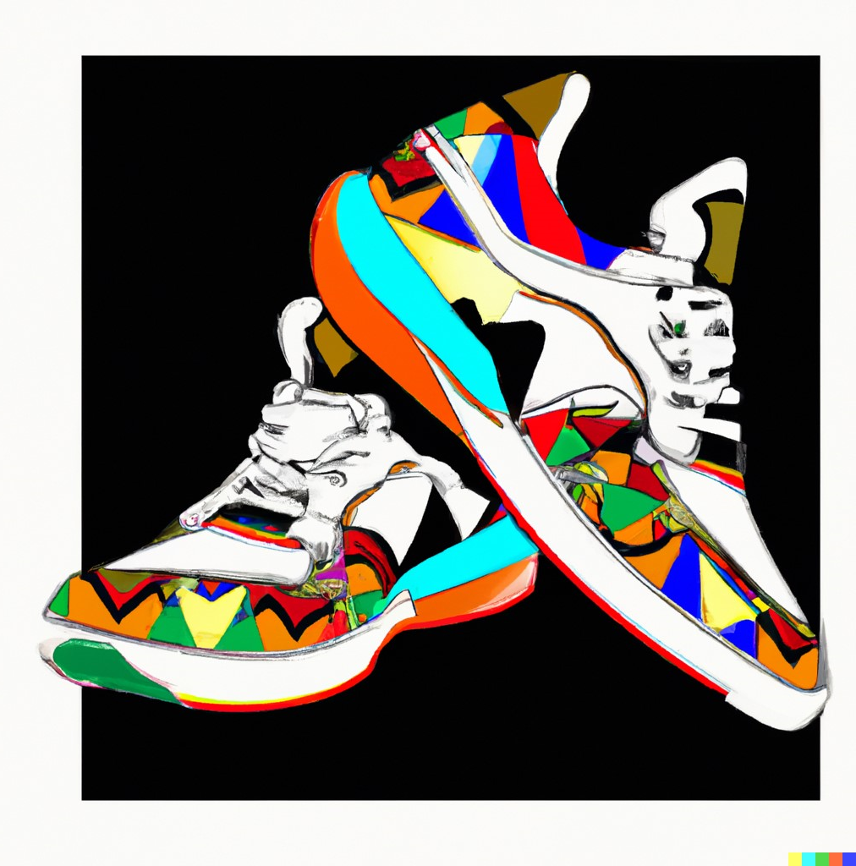
Ndebele design – inappropriate innovation
Left: Dr Esther Mahlangu – South African Ndebele artist
Above: DALL-E prompt: “Digital art Ndebele patterns on trainers”
https://arttimes.co.za/another-milestone-for-south-african-painter-at-85-dr-esther-mahlangu/
Notes:
Using community heritage to train AI tools: Copyright and Ethics
Dr Esther Mahlangu - Mahlangu’s abstraction is inspired by a tradition of geometric painting from her native country. The bold angular forms and flat colours that have defined Mahlangu’s art are rooted in Ndebele visual traditions. “In our tradition if a young woman cannot paint a straight line the potential in laws would say that she is not good marriage material. It became something that was essential to master and once mastered it becomes automatic, the straight lines and balance of each painting is non-negotiable and an essential part of Ndebele painting,” says Mahlangu. https://arttimes.co.za/another-milestone-for-south-african-painter-at-85-dr-esther-mahlangu/

Slide 27
Conclusion
AI use is going to affect ICH safeguarding
We need more participatory data governance
… even if ICH practitioners don’t directly use AI for their work, or if AI tools are not effective.
Communities concerned often don’t control their own data. This may undermine their ability to manage AI impacts,
The quality of cultural data matters
Participatory data governance needs to be tailored to community needs
Visibility, accuracy are affected by data availability. Some data is biased.
Some communities don’t want to have, or can’t exercise, tight control over their data. Others do.
Institutions and other actors that control access to ICH data still need to consider what would be in the broader public interest, even when communities do not want to, or cannot, exercise control.
Data governance in AI matters
AI needs data
We need to manage cultural data use in AI tools.

Slide 28
Thank you
H.Deacon3@hull.ac.uk

Slide 29
References
Amabie, T., Izah, S.C., Ogwu, M.C., Hait, M. (2024). Harmonizing Tradition and Technology: The Synergy of Artificial Intelligence in Traditional Medicine. In: Izah, S.C., Ogwu, M.C., Akram, M. (eds) Herbal Medicine Phytochemistry. Reference Series in Phytochemistry. Springer, Cham. https://doi.org/10.1007/978-3-031-21973-3_70-1.
Ayana et al. 2024 https://royalsocietypublishing.org/doi/10.1098/rsos.231994
Bouziane, K. and Echchaoui, M., 2024. Leveraging Artificial Intelligence for International Accessibility to Moroccan Linguistic Heritage: The Case of Translating Doukkala’s Ancient Proverbs. International Arab Journal of English for Specific Purposes, 7(1), pp.143-155.
Deng, M., Liu, Y. and Chen, L., 2023. AI-driven innovation in ethnic clothing design: an intersection of machine learning and cultural heritage. Electronic Research Archive, 31(9), pp.5793-5814.
Foroughi, M., Andrade, B. and Roders, A.P., 2024. Capturing experts’ knowledge in heritage planning enhanced by AI: A case study of windcatchers in Yazd, Iran. Journal of Cultural Heritage, 67, pp.1-8.
Huang, L. and Song, Y., 2022. Intangible cultural heritage management using machine learning model: a case study of Northwest Folk Song Huaer. Scientific Programming, 2022(1), p.1383520.
Khairina, N., Barus, R.K.I., Ula, M. and Sahputra, I., 2023. Preserving Cultural Heritage Through AI: Developing LeNet Architecture for Wayang Image Classification. International Journal of Advanced Computer Science and Applications, 14(9).
Rallis, I., Voulodimos, A., Bakalos, N., Protopapadakis, E., Doulamis, N. and Doulamis, A., 2020. Machine learning for intangible cultural heritage: a review of techniques on dance analysis. Visual Computing for Cultural Heritage, pp.103-119. Stacchio, L., Garzarella, S., Cascarano, P., De Filippo, A., Cervellati, E. and Marfia, G., 2024. DanXe: An extended artificial intelligence framework to analyze and promote dance heritage. Digital Applications in Archaeology and Cultural Heritage, 33, p.e00343.
Robles, M., Martínez, C.A., Prieto, J.C., Palacios, S. and Manrique, R., 2024, March. Preserving Heritage: Developing a Translation Tool for Indigenous Dialects. In Proceedings of the 17th ACM International Conference on Web Search and Data Mining (pp. 1200-1203).
Shan et al 2023. arXiv:2302.04222
Trochidis, K., Russell, B., Eisenberg, A., Ganguli, K.K., Gomez, O., Plachouras, C., Guedes, C. and Danielson, V., 2019. Mapping the sounds of the swahili coast and the arab mashriq: Music research at the intersection of computational analysis and cultural heritage preservation. In 6th International Conference on Digital Libraries for Musicology (DLfM), Delft, The Netherlands.
Weber, A., Heerlien, M., Gassó Miracle, E. and Wolstencroft, K., 2023. Introduction to the Special Issue on Digital Natural and Cultural Heritage: Opportunities and Challenges. ACM Journal on Computing and Cultural Heritage, 16(1), pp.1-4).
Zhang, B., Cheng, P., Deng, L., Romainoor, N.H., Han, J., Luo, G. and Gao, T., 2023. Can AI-generated art stimulate the sustainability of intangible cultural heritage? A quantitative research on cultural and creative products of New Year Prints generated by AI. Heliyon, 9(10).
Zhao, Ming, and Jiyuan Cui. "Artificial Intelligence Boosting Protection and Communication of Intangible Cultural Heritage." In 2022 International Conference on Artificial Intelligence, Internet and Digital Economy (ICAID 2022), pp. 1126-1133. Atlantis Press, 2022.

